Slide 1
The Analogous Structure of Accretion Flows in Supermassive and Stellar Mass Black Holes
John Ruan
McGill University & McGill Space Institute
In collaboration with: Scott Anderson, Mike Eracleous, Paul Green, Daryl Haggard, Chelsea MacLeod, Jessie Runnoe, Malgosia Sobolewska

Slide 2
Are AGN scaled-up versions of X-ray binaries?
To what extent are the structure of the accretion flows self-similar?
Does this analogy hold in different accretion states?
AGN
Scaled up by 10⁷?
XRB

Slide 3
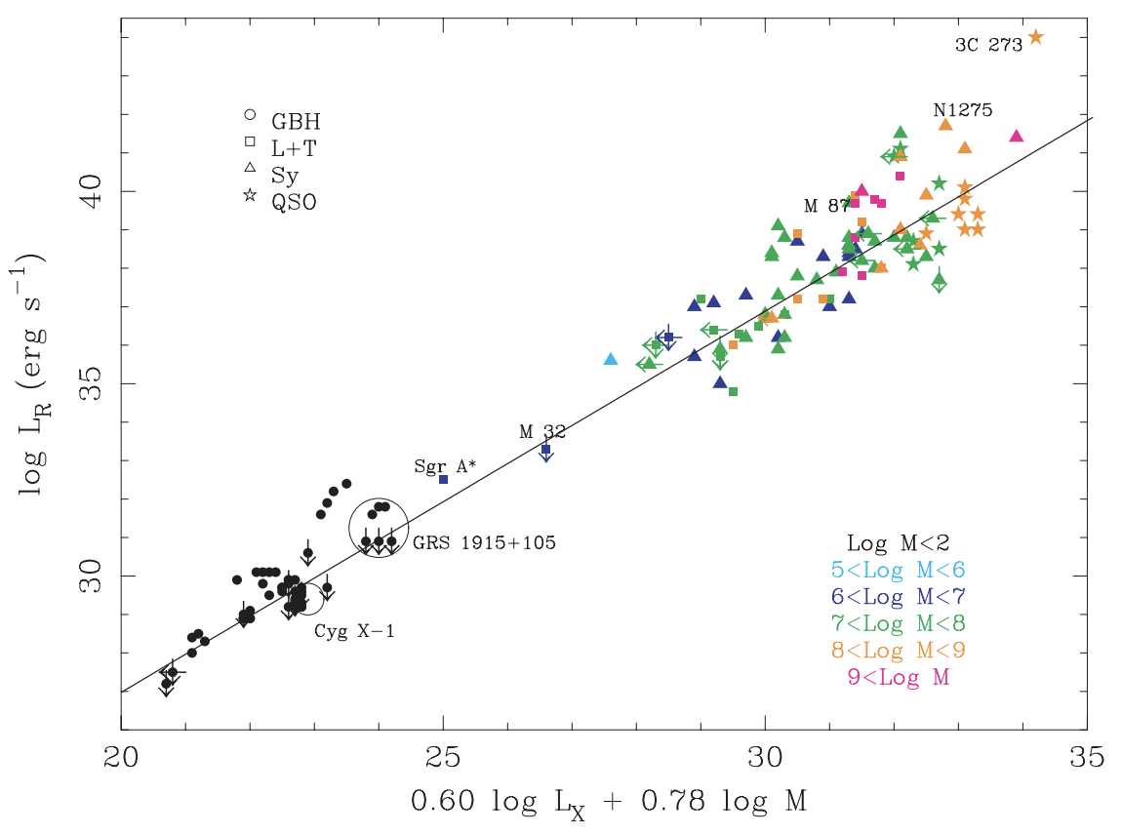
Fundamental plane of black hole activity suggests some link between low/hard state of X-ray binaries and low-luminosity AGN
softer
Relation between X-ray luminosity, radio luminosity, and black hole mass
Only for low/hard state(?)
Models suggest origin in self-similar jets or ADAF
Observed
Observed
harder
Merloni+00,
Falcke+01

Slide 4
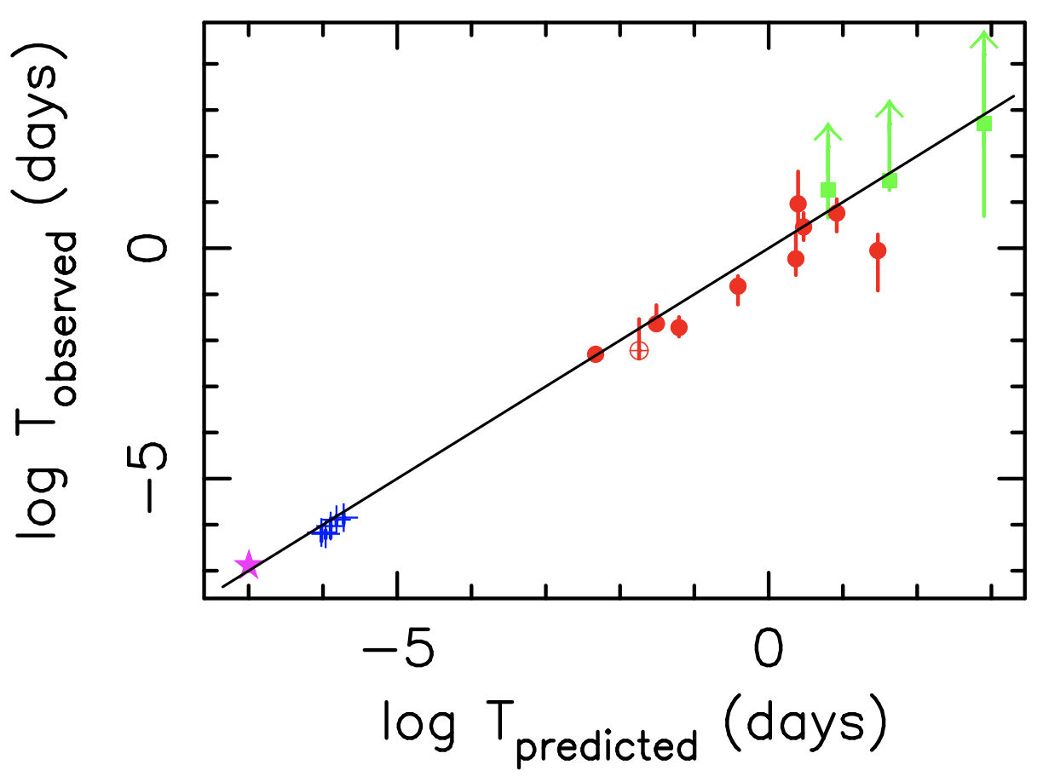
X-ray variability characteristic timescales also suggest some link between high/soft state of X-ray binaries and high-luminosity AGN
softer
Relation between X-ray characteristic timescale, X-ray luminosity, and black hole mass
Only for high/soft state(?)
Observed
Observed
harder
McHardy+06

Slide 5
Are AGN scaled-up versions of X-ray binaries?
To what extent are the structure of the accretion flows self-similar?
Does this analogy hold in different accretion states?
AGN
Scaled up by 10⁷?
XRB

Slide 6
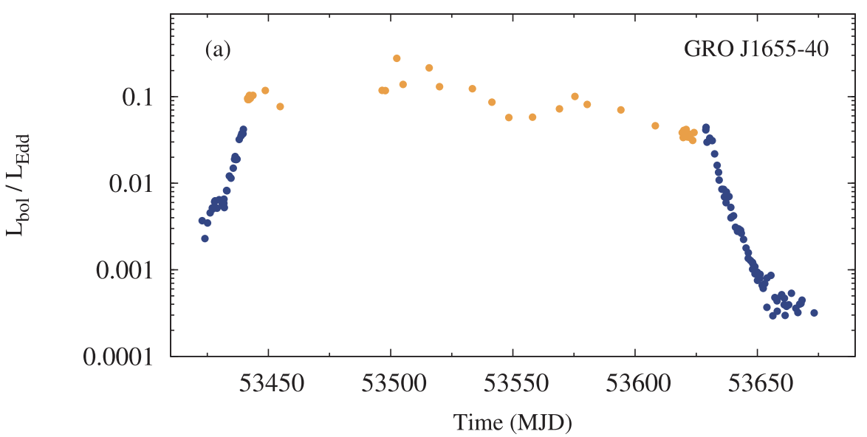
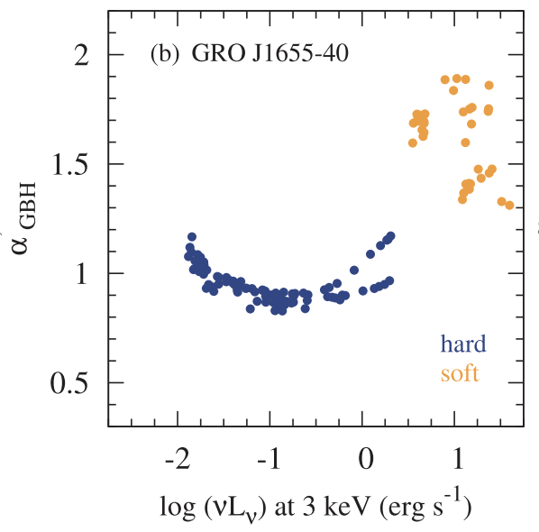
X-ray binaries in outburst display a characteristic spectral evolution
X-ray binary
softer
Observed
Observed
Eddington ratio (L/L_{Edd})
X-ray spectral index
harder
Time (MJD)
X-ray Luminosity
Sobolewska+11

Slide 7
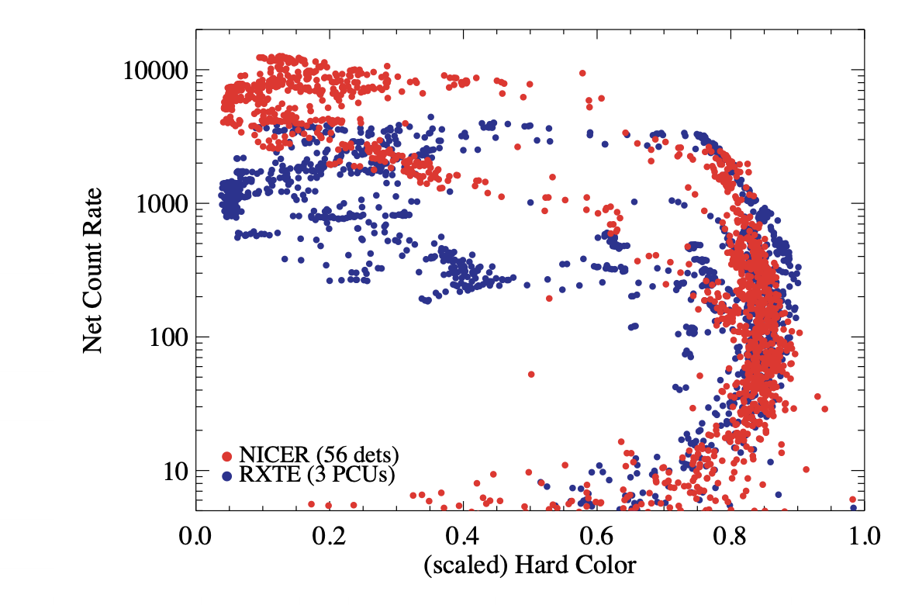
X-ray binaries in outburst display a characteristic spectral evolution
softer
harder
GX339-4
X-ray spectral index
X-ray count rate
harder
X-ray Luminosity
softer
X-ray hardness
Sobolewska+11
Courtesy of J. Steiner

Slide 8
The X-ray spectral index probes the evolution of their disk-corona system structure
softer
X-ray spectral index
harder
X-ray Luminosity

Slide 9
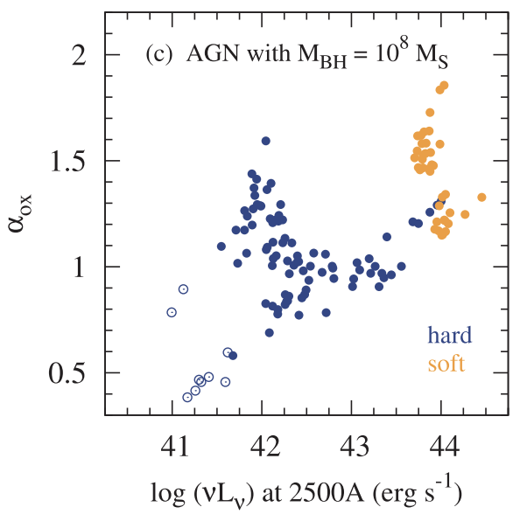
We can scale the disk and corona spectral components in X-ray binaries to predict what accretion state transitions look like in AGN
softer
softer
X-ray
binary
AGN
X-ray spectral index
UV/X-ray spectral index
harder
harder
X-ray Luminosity
UV Luminosity
Sobolewska+11

Slide 10
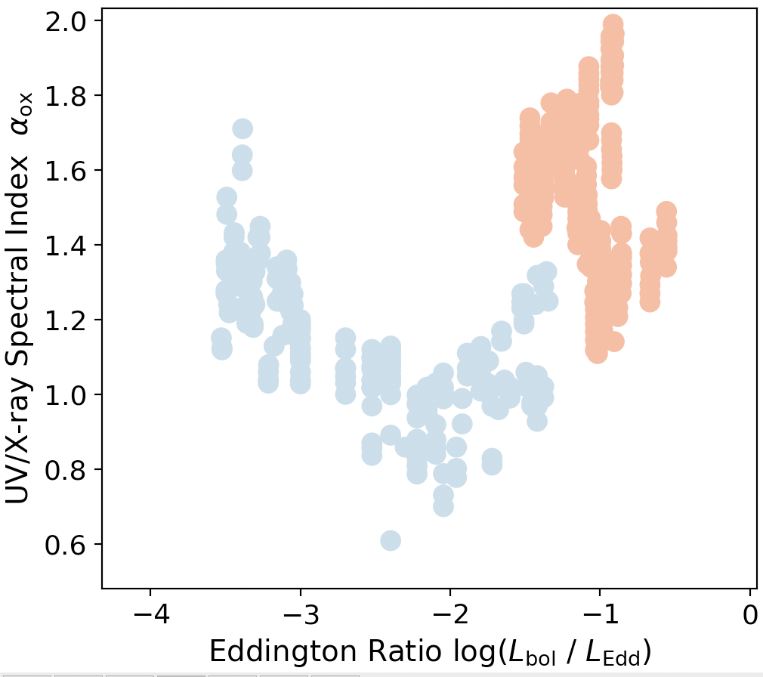
Test AGN/X-ray binary analogy by direct comparison of their spectral evolution during state transitions
softer
2 different approaches:
(1) Compare X-ray binaries to single-epoch observations of a sample of AGN that span a wide range of Eddington ratios
(2) Compare X-ray binaries to light curves of individual AGN undergoing large changes in Eddington ratio
Observed
Observed
harder

Slide 11
Approach 1: Compare X-ray binaries to single-epoch observations of a sample of AGN that span a wide range of Eddington ratios
softer
softer
Observed
Observed
harder
harder

Slide 12
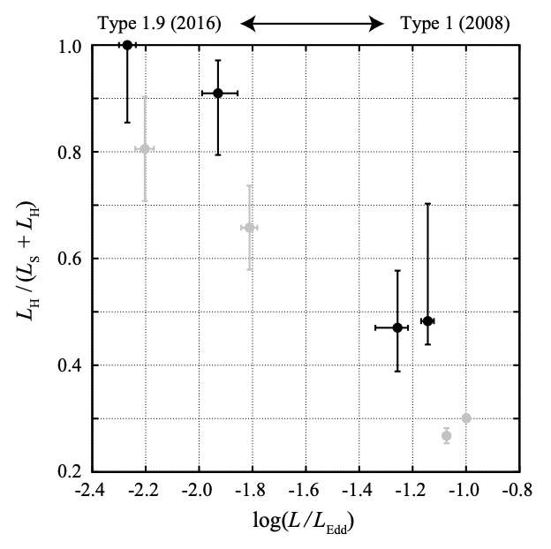
Approach 1: Compare X-ray binaries to single-epoch observations of a sample of AGN that span a wide range of Eddington ratios
softer
harder
Observed
Observed
softer
harder
Noda & Done 2018

Slide 13
Approach 1: Compare X-ray binaries to single-epoch observations of a sample of AGN that span a wide range of Eddington ratios
softer
softer
2 problems at lower L/L_{edd}:
how to get M_{BH} without broad emission lines?
How to avoid dust extinction?
Observed
Observed
harder
harder

Slide 14
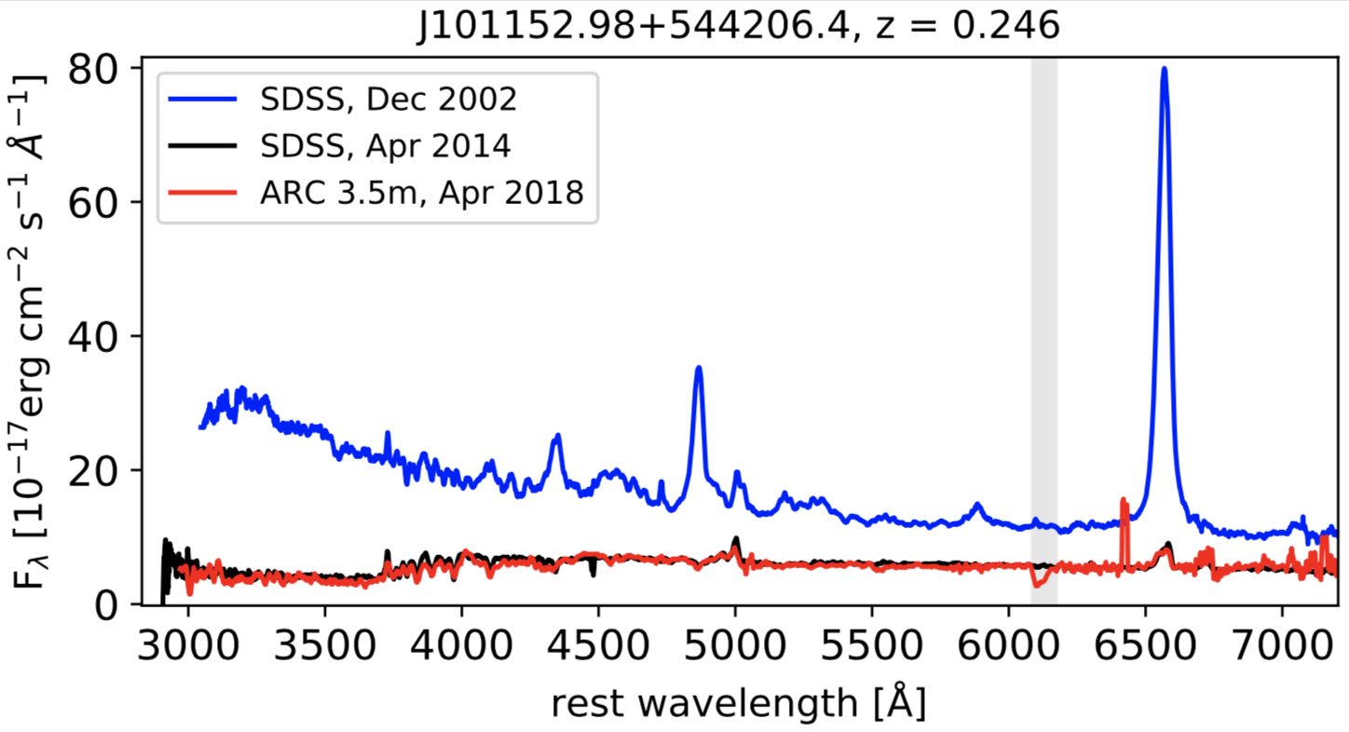
Changing-look quasars display dramatic fading of broad lines and continuum in repeat optical spectroscopy over timescales of just a few years
Observed
Runnoe+16

Slide 15
Changing-look quasars enable us to robustly probe the 𝛼_{OX} of AGN at low L/L_{Edd}
Bright state: measure M_{BH} from broad lines
Faint state: measure 𝛼_{OX} using optical spectrum and Chandra
Observed

Slide 16
Main result: Single-epoch observations of AGN samples reveal remarkably similar spectral evolution of AGN and X-ray binaries
softer
harder
Ruan+19,
submitted

Slide 17
The X-ray spectral index probes the evolution of their disk-corona system structure
softer
X-ray spectral index
harder
X-ray Luminosity

Slide 18
Overall conclusion: AGN and X-ray binaries display similar spectral evolution over a wide range of Eddington ratios Broader implication: this suggests that the structure of accretion flows in X-ray binaries and AGN are analogous
Observed
Observed
harder

Slide 19
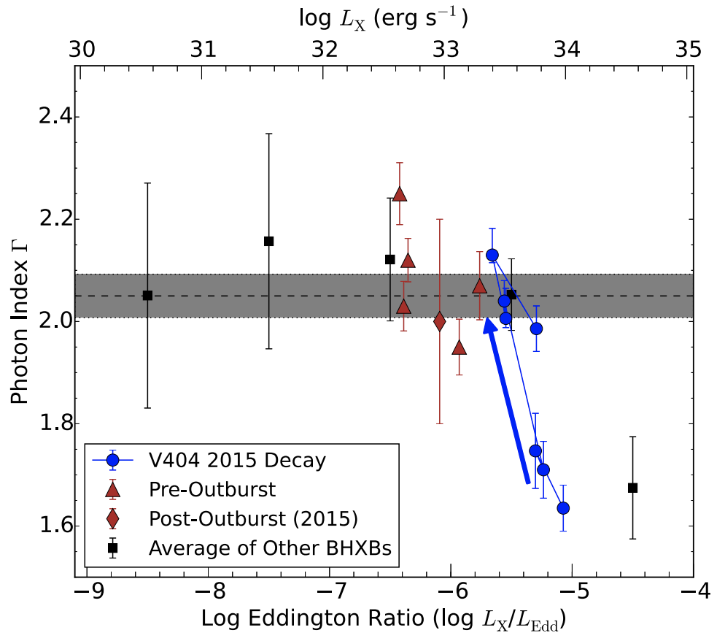
Additional test of AGN/XRB analogy: directly following changing-look quasars to quiescence
softer
Observed
Observed
harder
Plotkin+17

Slide 20
The mismatched timescale problem between AGN and X-ray binaries still persists
softer
Observed
Observed
harder

Slide 21
Overall conclusion: AGN and X-ray binaries display similar spectral evolution over a wide range of Eddington ratios Broader implication: this suggests that the structure of accretion flows in X-ray binaries and AGN are analogous
Observed
Observed
harder

Slide 22
Extra Slides
Observed

Slide 23
Decomposition of optical spectra and fitting of the quasar component
softer
Observed
Observed
harder
Ruan+19,
submitted

Slide 24
Extrapolation of the power-law from optical spectroscopy into the UV is not an issue
softer
Observed
Observed
harder
Ruan+19,
submitted

Slide 25
Bolometric corrections are not an issue
softer
Observed
Observed
harder
Ruan+19,
submitted

Slide 26
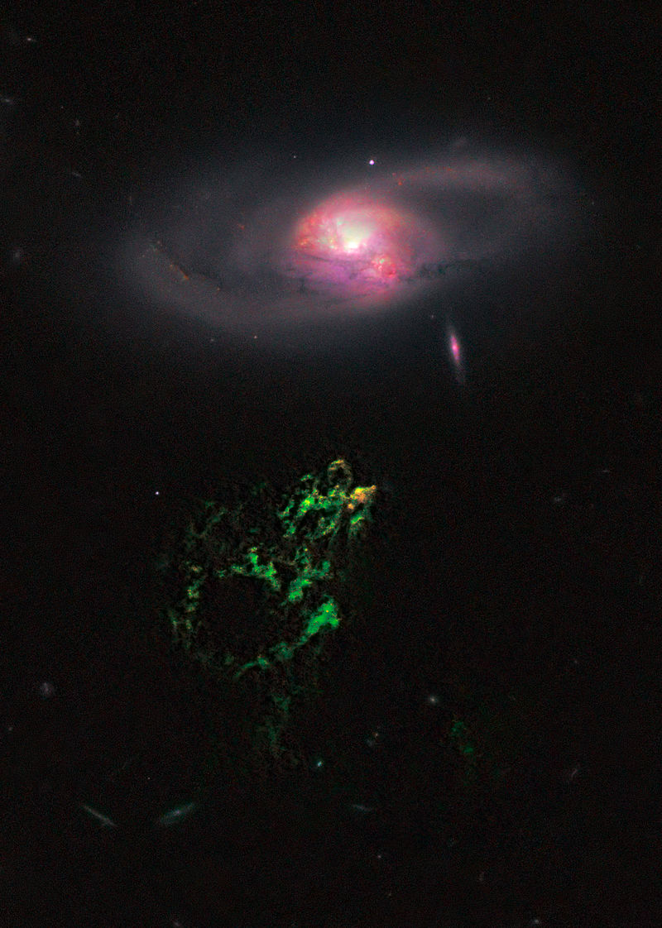
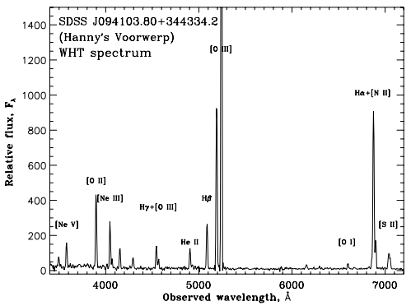
Hanny’s Voorwerp
Previous evidence for AGN accretion state transition in quasars
Lintott+12
Keel+12

Slide 27
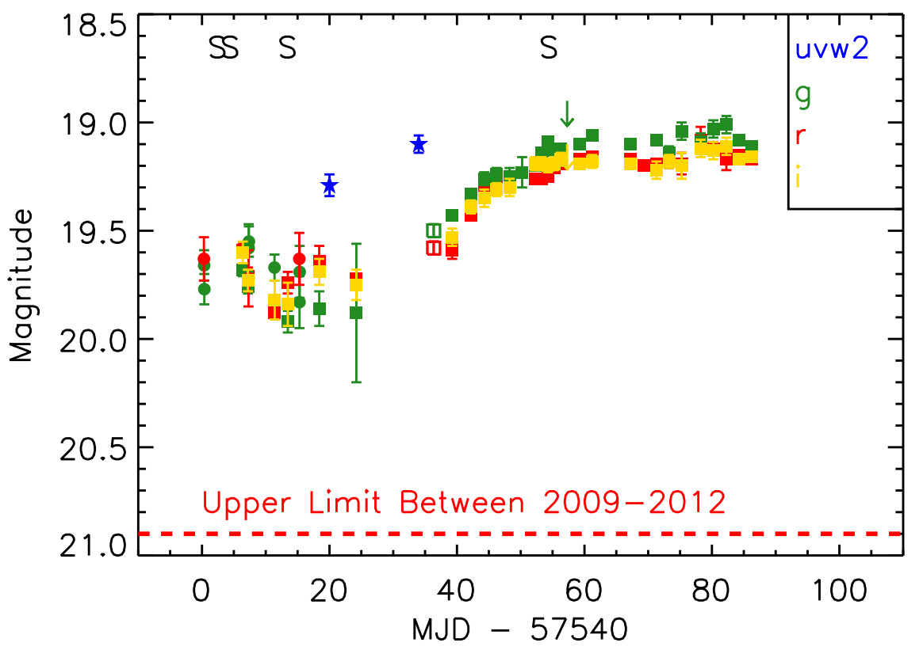
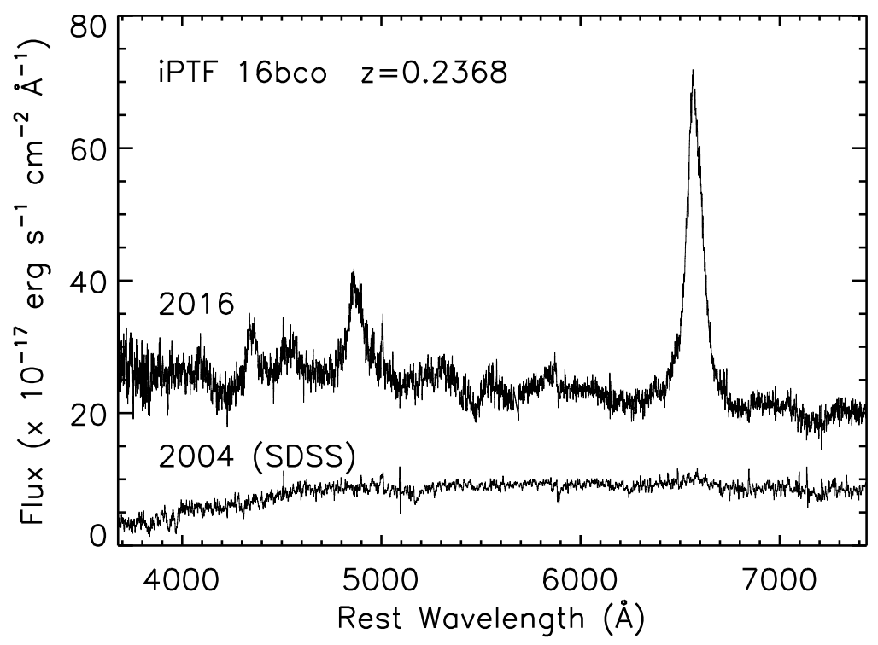
Discovery of ‘turn-on’ changing-look quasars
Gezari+17

